Slide 1


60 days to a New You!!!

Slide 2
60 days To A New You Without Pre-Packaged Food or Dangerous Medications!

Slide 3
What is the True Weight Solutions program?
Doctor Supervised Weight Loss Program Composed of:
Proprietary No-Shot, No Rx Formula
Amino Acids
Vitamins
Detoxification
Dietary/Behavioral Modifications
Supervision By A Doctor
Doctor supervision ensures that it is safe for both men and women as long as you are not pregnant or breast feeding, or have active cancer.

Slide 4

What Does True Weight Solutions Do?
Reduces Inflammation
Boosts Metabolism
Boosts Energy Levels
Causes Body To Burn More Fat
Helps Body Establish New “Set Points” and Resets Metabolism
Both Safe and Effective

Slide 5
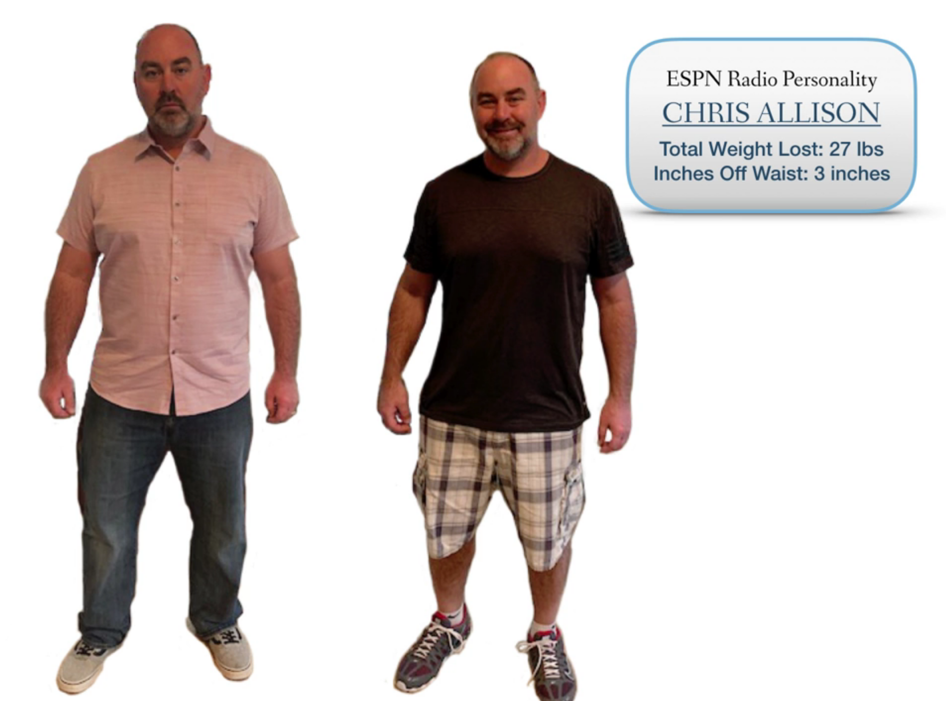
True Weight Solutions Program Success
Chris A.. Lost 27 Pounds & 3 Inches in 60 Days!

Slide 6

Traditional HCG
Very expensive
Daily injections
Excessive fat loss causes toxicity
Always hungry

Slide 7

How True Weight Solutions Works
Doctor Based Dietary & Behavioral Guidance combined with the TWS Formula
TWS Program Works to:
  Burn Fat
  Suppress Hunger
  Eliminate Cravings
  Establish New “Set Points” for BMI and BMR
  Create New Behavioral/Dietary Habits

Slide 8

What Is The TWS Diet?
Eat when hungry, NO Starvation
ALL Natural
Certain Blends & Amounts of Lean Protein, Vegetables, and Fruits
Low Glycemic Index
Anti-Inflammatory

Slide 9

Why The True Weight Solutions Program
Our Exclusive & Proprietary Program Is Doctor-Designed & Includes…
Doctor Supervision
Physician Designed Formulation without the need for prescriptions and/or injections!
L-Carnitine for metabolism boost, fatty acid transportation and energy production.
Arginine and Ornithine for detox, heart health, blood sugar regulation, healthier skin and muscles
Liquid B12 for higher energy levels and increased metabolism without jitters!
These are just a few of the ingredients and things that sets the Doctor Supervised True Weight Solutions Program apart from other weight loss programs.

Slide 10
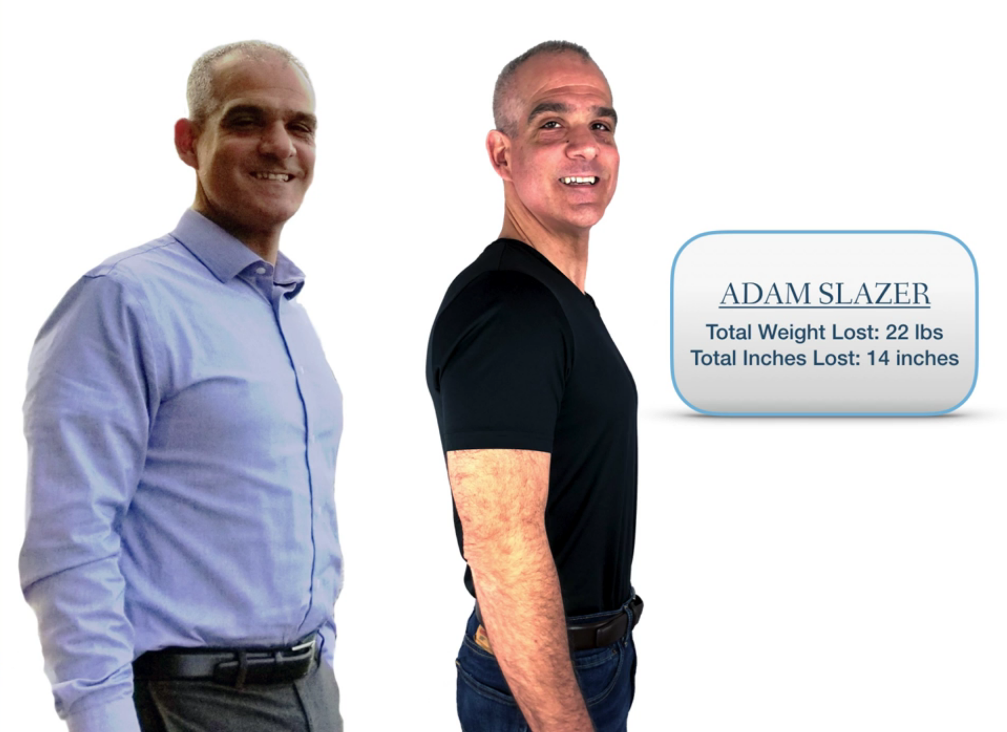
TWS Program Success
Adam S. Lost 22 Pounds & 14 Inches In 60 Days!

Slide 11
True Weightloss Program Saves you money
 | Cost to lose 30 LBS | Cost Per Pound | Time to lose 30 LBS
Zone Diet (no fat burning) | $3800 | $127 | 30 Weeks
Jenny Craig (no fat burning) | $4300 | $144 | 30 Weeks
Nutri-System (no fat burning) | $4000 | $134 | 20 Weeks
Weight Watchers (no fat burning) | $3000 | $97 | 20 Weeks

Slide 12
Details
Initial Consultation
Includes health history, height, weight, 5-point body measurements, counseling, Q&A Session, BMI Calculation, Review of instructional manual.
60 Day Supply of TWS Formula
Doctor Designed injection-free formula designed to support the body by helping with detox, muscle protection, hunger/craving suppression, blood sugar stabilization, amino acids, vitamin B12.
Maintenance Instructions
Two accountability visits after your program with individual maintenance recommendations to help ensure long term success.

Slide 13
Details
Comprehensive Instruction Manual and Doctor’s Nutrition Expertise
Provides all information and support needed to have fast, long-term weight loss!
TWS Friendly Recipes included
Delicious recipes to keep the diet interesting. Just say no to bland food!
Daily Weight Log and Food Journal
Keeps you on track by helping you to log your weight and think about your dietary and behavioral choices every day!

Slide 14

Health Related FAQ’s
Is the TWS Program safe if I have…
Diabetes
Thyroid Problems
HBP/Heart Problems
Cancer Free 2 years
Hysterectomy
YES!

Slide 15
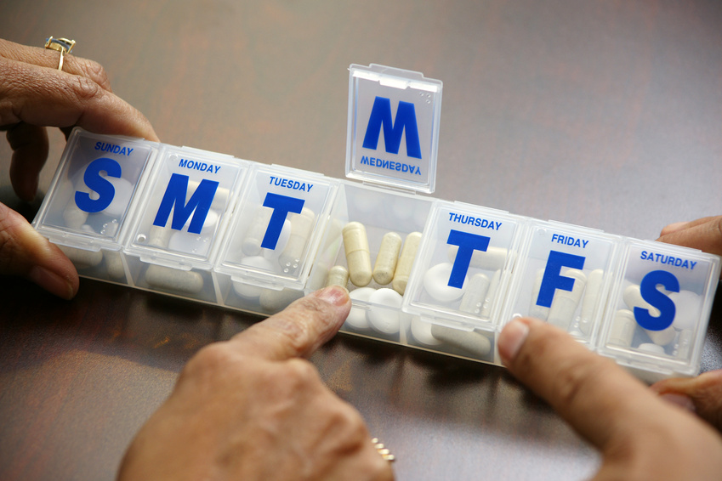
Health Related FAQ’s
Is it safe if I’m on or take?
Yes – there are no known contraindications to any medications
HRT…
Lose weight more slowly
Substantial loss in inches

Slide 16
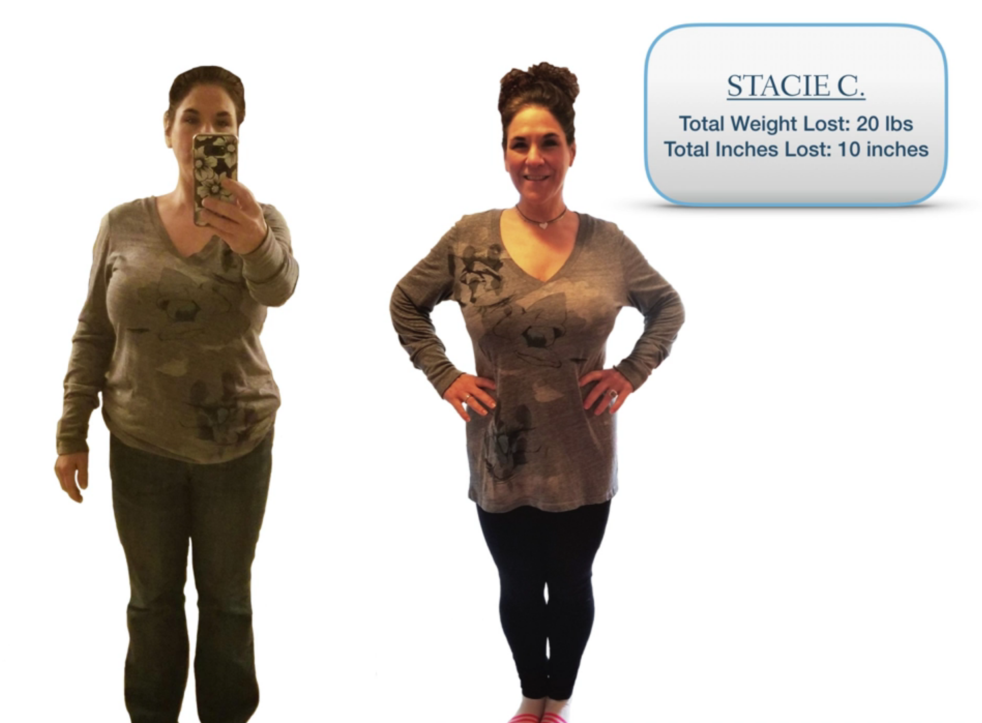
TWS Program Success
Stacie C.. Lost 20 Pounds & 10 Inches In 60 Days!

Slide 17
True Weightloss Program Overview
Doctor Supervised Weight Loss and Accountability Visits
True Diet Drops
True Keto Drops
B12 Supplement
True Vegan Protein-Vanilla (optional)
Weekly 5-point measurements tracking

Slide 18
TWS Program Overview
AND…..
While we are confident that you will enjoy the changes you experience in your body and overall results.
If you haven’t reached your goals after your initial 60-day program, we offer a $50 discount for follow up programs.

Slide 19

Option 1 – Hands on Tracking $1099
90-day True Weight Solutions program
Weekly Office visits with weigh in, measurements, and doctor check-in at the clinic
Option 2 – Hands on and Then Some $1199 (Athlete/Diabetic/Vegan)
90-day True Weight Solutions program
Weekly Office visits with weigh in, measurements, and doctor check-in at the clinic
Organic Protein Supplement – Vegan protein to help athletes recover after exercise, help balance blood sugar fluctuations for diabetics and help support the protein needs of vegetarians/vegans on the program
Option 3 – Hands on Digestion $1249
90-day True Weight Solutions program
Weekly Office visits with weigh in, measurements, and doctor check-in at the clinic
Nutritional Supplement to assist patients with digestive difficulties
    - Probiotics to build a healthier gut microbiome
- Digestive Enzymes to assist with nutrient absorption
- Magnesium to support the digestive system (enzymes, digestive acids, bowel movements)

